Slide 1
DATA ANALYTICS

Slide 2
Data Analysis
It is the process of Collecting, Cleaning, Transformation & Analyzing the data.
In that data we can create a report or create useful insights are called as Data Analysis.

Slide 3
Data
Data refers to a collection of information, facts, or observations that represent information.
Data is the foundation of information and knowledge.
Through data processing and data analysis, organizations transform raw data points into valuable insights
That improve decision-making and drive better business outcomes.

Slide 4
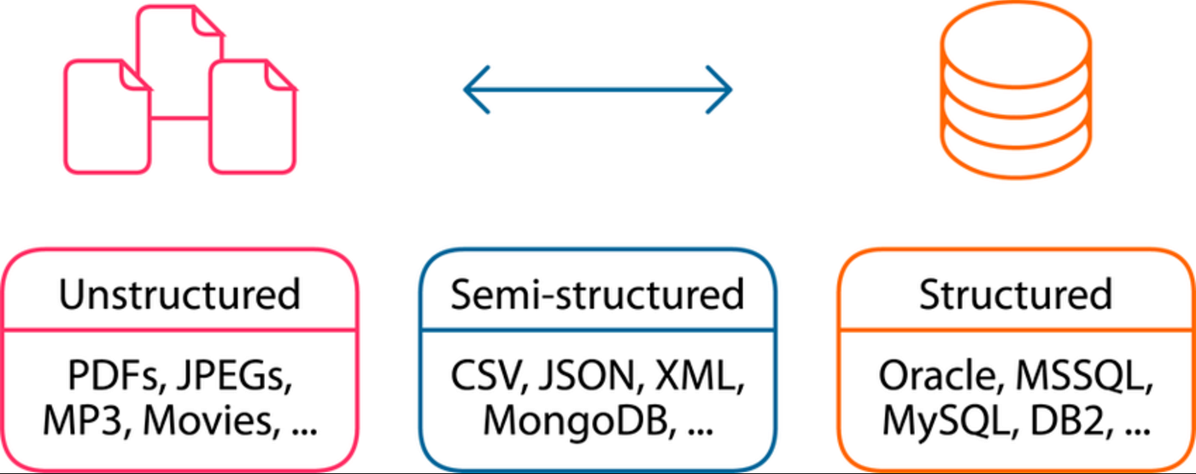
Different Types of Data
Unstructured Data
Semi – Structured Data
Structured Data

Slide 5
Structured Data
It have fixed rows and columns format in storage.
At least 80% of data are structured.
The human generated structured data are those which are taken from a human, like their name, age, address, etc…,
The structured data are those types of data which are stored in an order.
Example: Tables

Slide 6
Unstructured Data
It have not cleared format in storage.
At least 80% of data are unstructured.
They are various type of human – generated data.
These are image, videos, pdf, etc…,

Slide 7
Semi – Structured Data
Semi-structured data is partially organized data that does not fit neatly into rows and columns but still contains identifiable structure.
They are various type of file format like as JSON, XML, etc…,

Slide 8
Data Engineer
Data engineers are software engineers who build and maintain an enterprise’s data infrastructure.
Automating data integration, creating efficient data storage models and enhancing data quality via pipeline observability.
Data scientists and analysts rely on data engineers to provide them with the reliable, high-quality data they need for their work.

Slide 9
Data Analytics
Data analytics is part of Data Science.
Data analytics is a multidisciplinary field that employs a wide range of analysis techniques, including math, statistics, and computer science, to draw insights from data sets.
Data analytics is the practice of examining raw data to identify patterns, generate insights, and support better decision-making.

Slide 10
Data Science
Data Science is an in-disciplinary field combining statistics, mathematics, programming and AI to extract actionable insights from large, complex or raw data’s.
It empower business predict trends, automated process and optimizing decision-making using tools like python, R, SQL, and Machine Learning.

Slide 11
Responsibilities of Data Analyst
Data collection
  Data Analysts collect data from diverse source, ensuring accuracy, completeness and currency
Data Cleaning & Transformation
  Raw data to prepare it for analysis by removing duplicates, handle missing values, and ensuring consistent formatting
Exploratory Data Analysis [EDA]
  Use Statistical and analytical techniques to analysis data including statistical analyses, predictive modelling and trend identification.
Data Visualization
  Utilize data visualization tools and present insights through charts, graphs, dashboards effectively.

Slide 12
Types of Data Analytics
Descriptive Analytics (What happened?)
  Summarizes historical data to understand changes in business, such as sales trends, year-over-year growth, or monthly reports.
Diagnostic Analytics (Why did it happen?)
  Drills down into data to identify root causes of trends or anomalies, such as determining why churn increased or why sales dipped in a specific region.
Predictive Analytics (What is likely to happen?)
  Uses historical data, machine learning, and AI to forecast future probabilities, such as customer behavior, demand planning, or risk assessment.
Prescriptive (What should we do?)
  Recommends specific actions to take advantage of predictions, optimizing processes like supply chain logistics, pricing strategies, or personalized marketing.

Slide 13
Why Data Analysis is Important
Better decision making
Customer Insights
Identify problems
Increase profit
Reduce loss
Examples:
  Netflix
  Amazon
  Flipkart
  Hospital
  Cricket Analysis

Slide 14








Fields involved in Data Analytics
Financial
Retail
Inventory
Manufacturing
Health Care
Energy
Sports
Medias

Slide 15
Data Analysis Tools
Tools | Percentage
Microsoft Power BI | 36%
Tableau Desktop | 20%
Qlik Sense | 11%
SAP Analytics Cloud | 11%
IBM Cognos Analytics | 7%
Looker | 6%
Strategy Analytics | 5%
Sisense | 4%
Oracle Analytics Server | 1%

Slide 16
 | Power BI | Tableau
Usability | Simple and familiar user interface makes it easy to get started | Doesn’t require specialised knowledge but not as user friendly as Power BI
Best For | Analysing personalised data but can convert data from multiple sources with optional software add-on | Built to represent large data sets from multiple sources
Data Handling | Power BI is limited to 1GB per data set and 10GB per user. With Power BI premium this increase to 10GB per dataset and 100TB across all users. | Limited to 100GB capacity for work book and data source
Data Source | Can access a multitude of database and cloud services including SQL, SAP, HANA, and Oracle | Can access a huge number of server and data sources
Features | Power BI is an effective data visualisation tool that is constantly evolving. | Tableau is feature rich and highly customisable – through more complex than Power BI
Deployment Option | Delivered as a cloud service particularly Ideal for smaller organisations | Can be delivered as a cloud service on – premise or via a third-party cloud provider
Cost | Easy to get started with low cost per user pricing | Higher cost balanced by richer features and data handling capabilities.

Slide 17
What is Power BI
Power BI is a Business Intelligence platform that transforms raw data into meaningful stories through the interactive dashboards and visual analytics, enabling organizations to make Faster and Smarter decisions.
Why Power BI?
  Large Data’s Analysis
  Excel Integration
  Real time Analysis
  Turns into Meaningful Insights
  Rich features
  More flexibility.

Slide 18
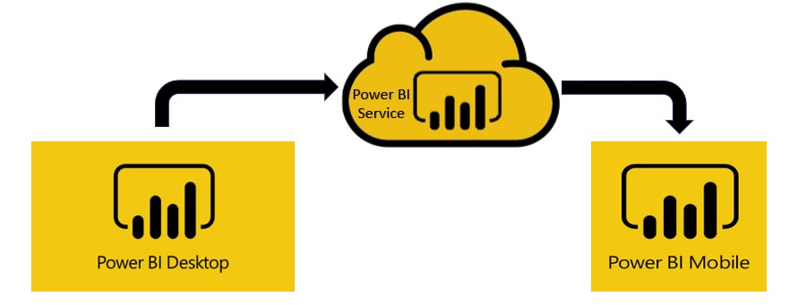
Power BI Different Tools
Power BI Desktop
Power BI Service
Power BI Mobile

Slide 19
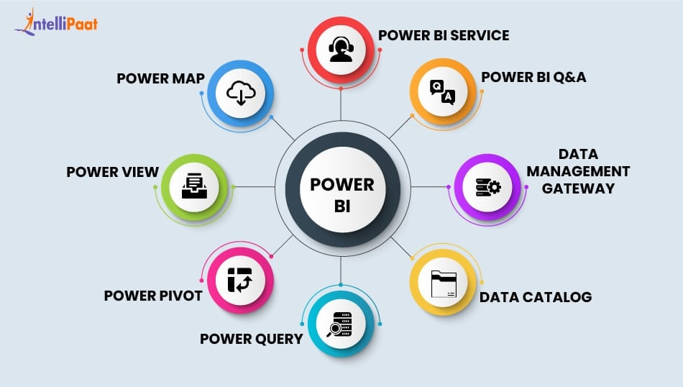
Components of Power BI

Slide 20
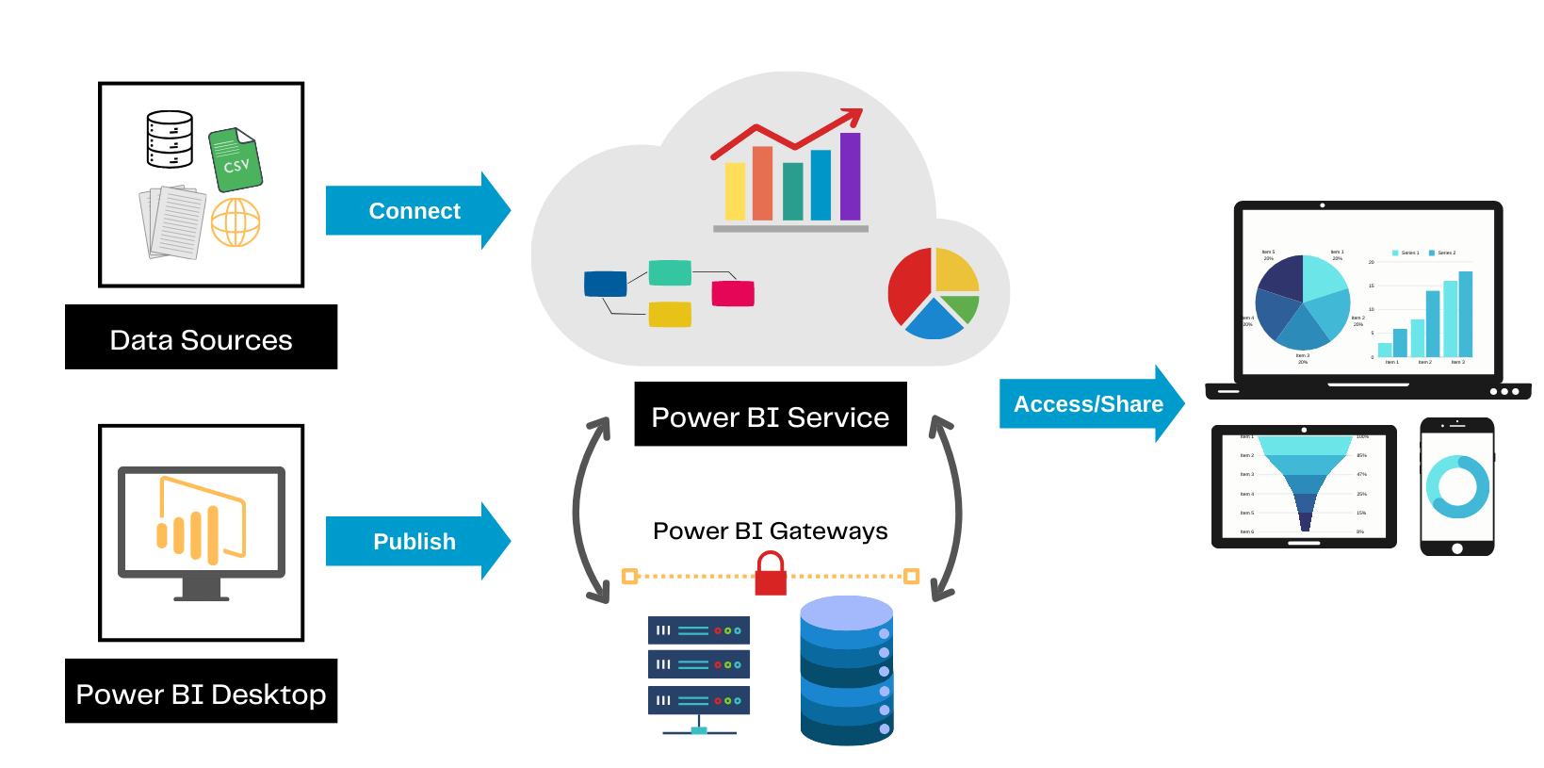
Architecture of Power BI

Slide 21
Data Types in Power BI
Text
Number
  Fixed Number
  Whole Number
  Percentage
  Decimal
  Binary
Date & Time
  Date
  Time
  Duration
Boolean (or) Logical

Slide 22
BASIC CHARTS

Slide 23
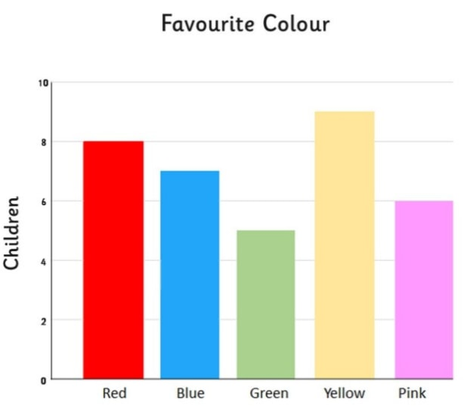
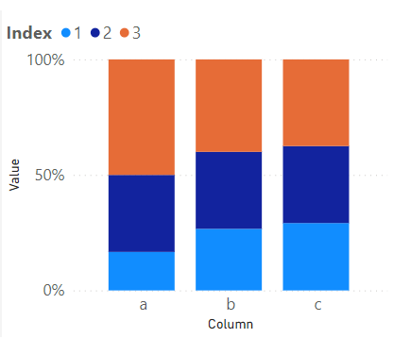
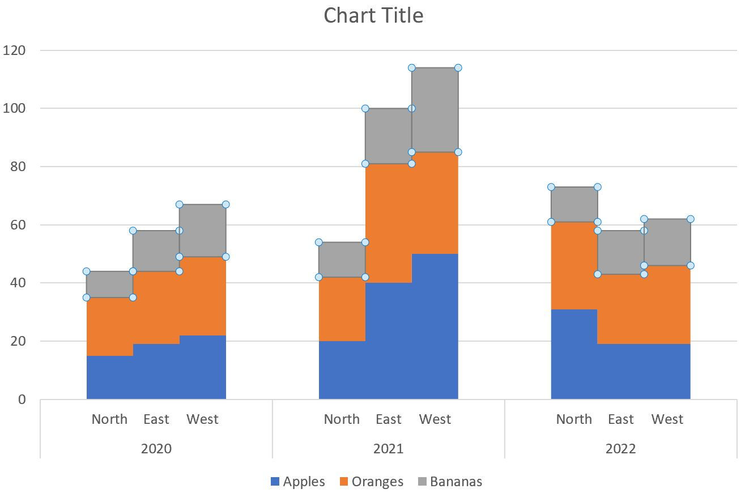
Column / Stacked / Cluster Column Chart

